Slide 1

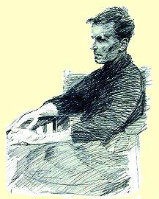
Making Sense of Wittgenstein
Introductory lecture for INFO116
Bergen, 1.10.15
Rune J. Falch
Wittgenstein Archives Bergen [WAB]

Slide 2
What is WAB?
A small research infrastructure part of the department of philosophy
Produces digital editions of Wittgenstein’s writings (primary sources)
Maintains and expands a collection of commentary resources (secondary sources)
Collaborates on developing improved ways of searching and browsing the sources (e.g. by using Semantic Technologies)

Slide 3
Our resources
Wittgenstein’s Nachlass – The Bergen Electronic Edition [20,000 pages on CD-ROM in different editions]
WittgensteinSource [primary sources, OA, Open Source]
WittgensteinRepository [secondary sources, OA, OS]
WAB ontology
Pundit, Wittfind…
Open Access online journal Nordic Wittgenstein Review

Slide 4
«Your» material
A small selection from our online resources
Wittgenstein’s Lecture on Ethics (WittgensteinSource.org/ HyperWittgenstein)
Some commentary papers on the Lecture (mainly from WittgensteinRepository.org)
InPhO, Schema.org, DublinCore, etc.

Slide 5
Philosophy from Wittgenstein on
‘After Wittgenstein, all philosophy is philosophy of language’…
The «linguistic turn» in philosophy
Wittgenstein and colleagues start turning their attention away from answering questions and instead focus on how language works…
…for can we really take it for granted that when we ask a (philosophical) question that it always actually has meaning?
Are questions like «What time is it?» and «What is time?» of the same kind? Does language work the same way here?

Slide 6

Wittgenstein’s «picture theory» of language
Language depicts the world, just like the model represents a real situation in the world.
Language and the world share a certain “form”, a logical structure.
Language says that this situation is so and so [true or false].
The logic shared between the world and language shows itself in language [it’s what gives sense or meaning to what we say].

Slide 7
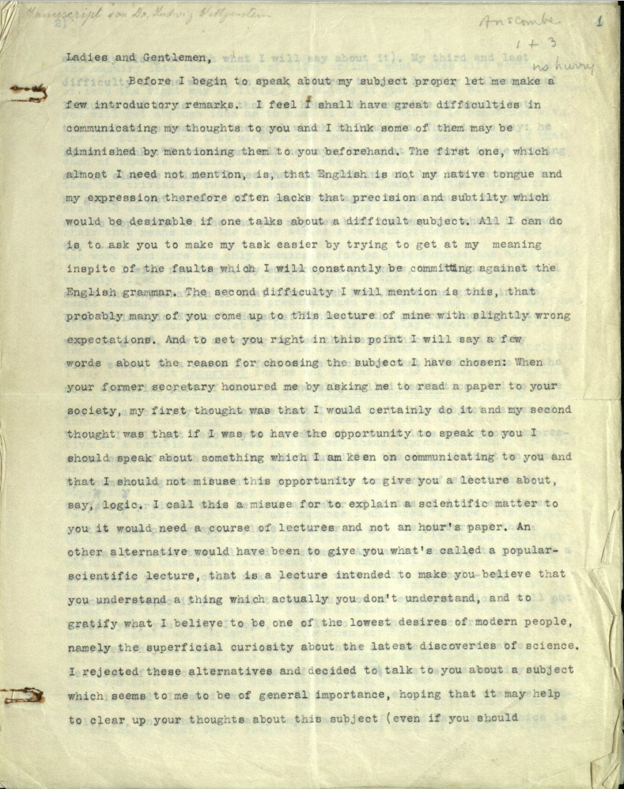
Lecture on Ethics (Ms-139a & Ts-207)
WittgensteinSource.org
HyperWittgenstein
(Above is the typescript, of course.)

Slide 8
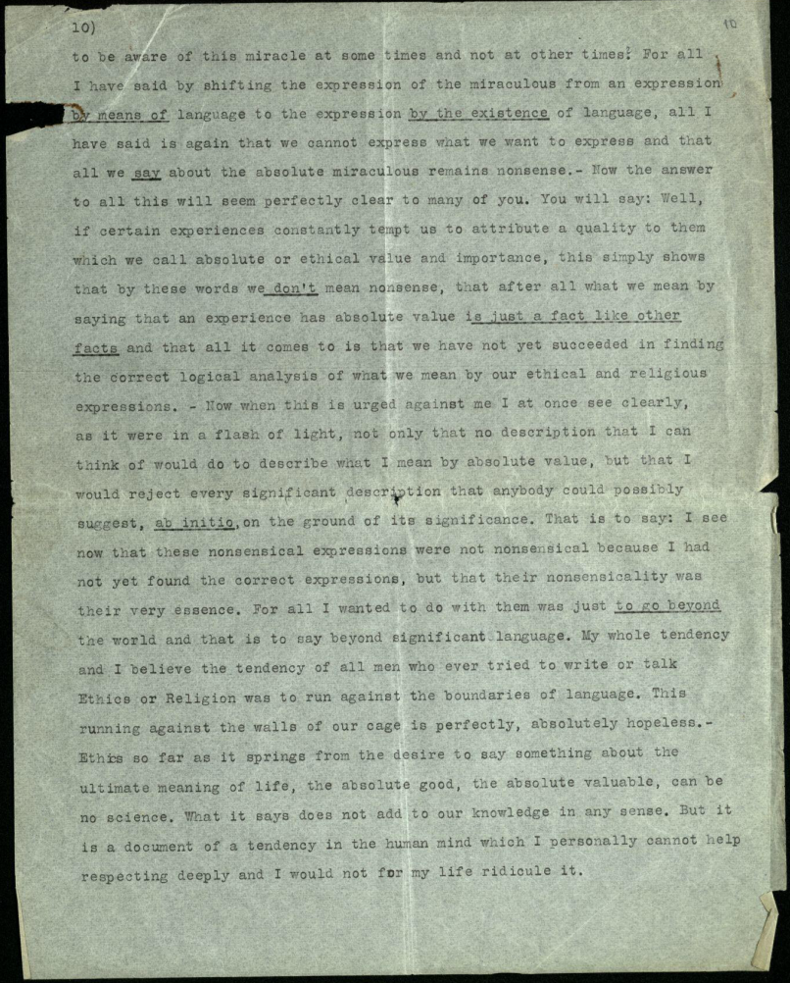

Slide 9
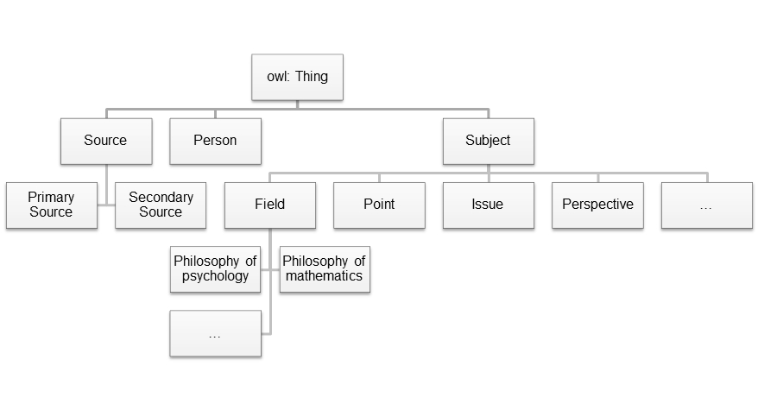
WAB’s Wittgenstein ontology

Slide 10
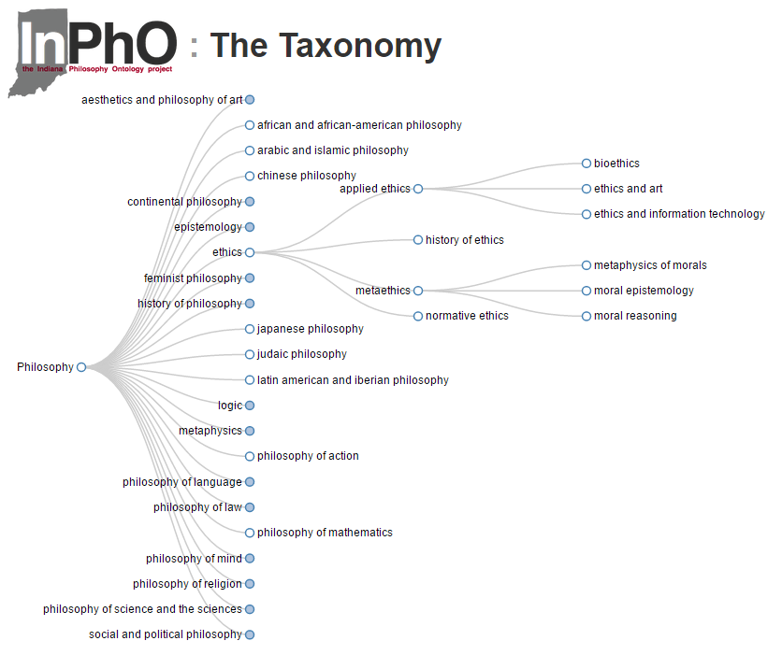
The Indiana Philosophy Ontology Project

